Slide 1


Green Pace
Security Policy Presentation
Developer: Zachary Gonzalez

Slide 2
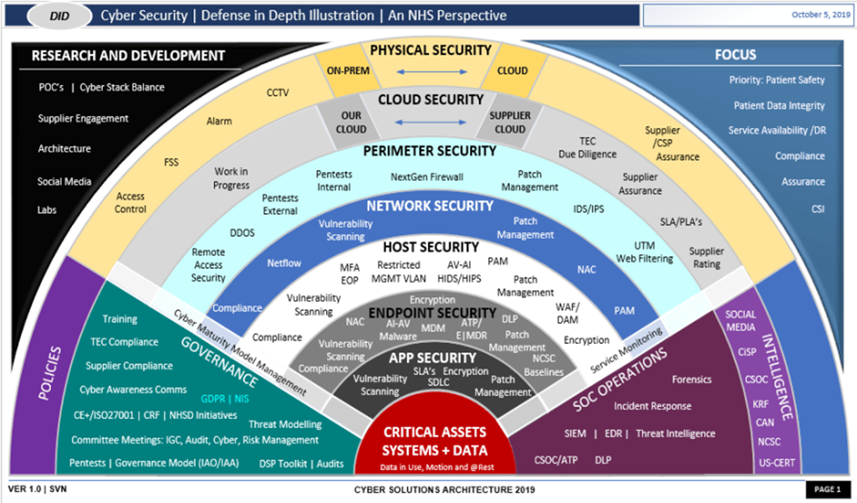
OVERVIEW: DEFENSE IN DEPTH
Core Security Principles
C/C++ Coding Standards
Triple-A Standards
Encryption Standards
Redundant Defense

Slide 3
THREATS MATRIX
Likely Threats Most Likely to Occur | Priority Red (P9,P12)
Low priority White/Yellow (P1,P4, P6) | Unlikely Threats Least Likely to Occur

Slide 4
10 PRINCIPLES
Validate Input Data (STD 001, 002, 003, 004)
Heed Compiler Warnings (STD 002, 003, 010)
Architect for Security Policies (STD 002, 004, 005, 006, 007, 008, 009, 010)
Keep it Simple (ALL)
Default Deny (STD 004)
Adhere to Principle of Least Privilege (STD 004, 008, 010)
Sanitize Data Sent to Other Systems (STD 003, 004)
Practice Defense in Depth (STD 004)
Use Effective Quality Assurance Techniques (STD 001, 002, 003, 005, 006, 007, 008, 010,)
Adopt a Secure Coding Standard (STD 005, 006, 007, 008, 009, 010)

Slide 5
CODING STANDARDS
Standard | Name | Severity | Likelihood | Remediation Cost | Priority | Threat Level
1 | Data Type | High | Likely | High | P9 | L2
2 | Data Value | High | Likely | High | P9 | L2
3 | String Correctness | High | Likely | Medium | P18 | L1
4 | SQL Injection | High | Likely | Medium | P18 | L1
5 | Memory Protection | High | Likely | Medium | P18 | L1
6 | Assertions | Low | Unlikely | High | P1 | L3
7 | Exceptions | Low | Probable | Medium | P4 | L3
8 | Expressions | High | Probable | High | P6 | L2
9 | API Vulnerability | High | Probable | Medium | P4 | L3
10 | OOP | High | Probable | High | P6 | L2

Slide 6
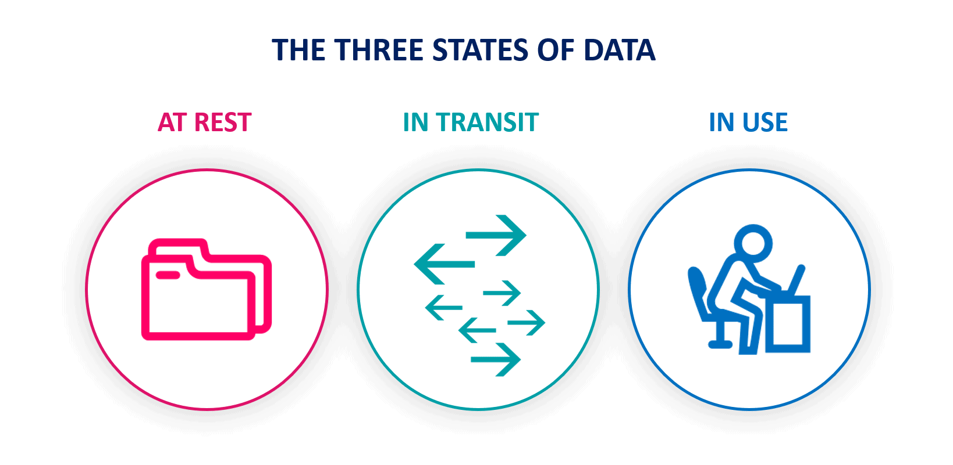
ENCRYPTION POLICIES
In Rest – Full-disk encryption, database encryption
At Flight – Secure libraries, Public Key infrastructure
In Use – Identity Management, conditional access

Slide 7
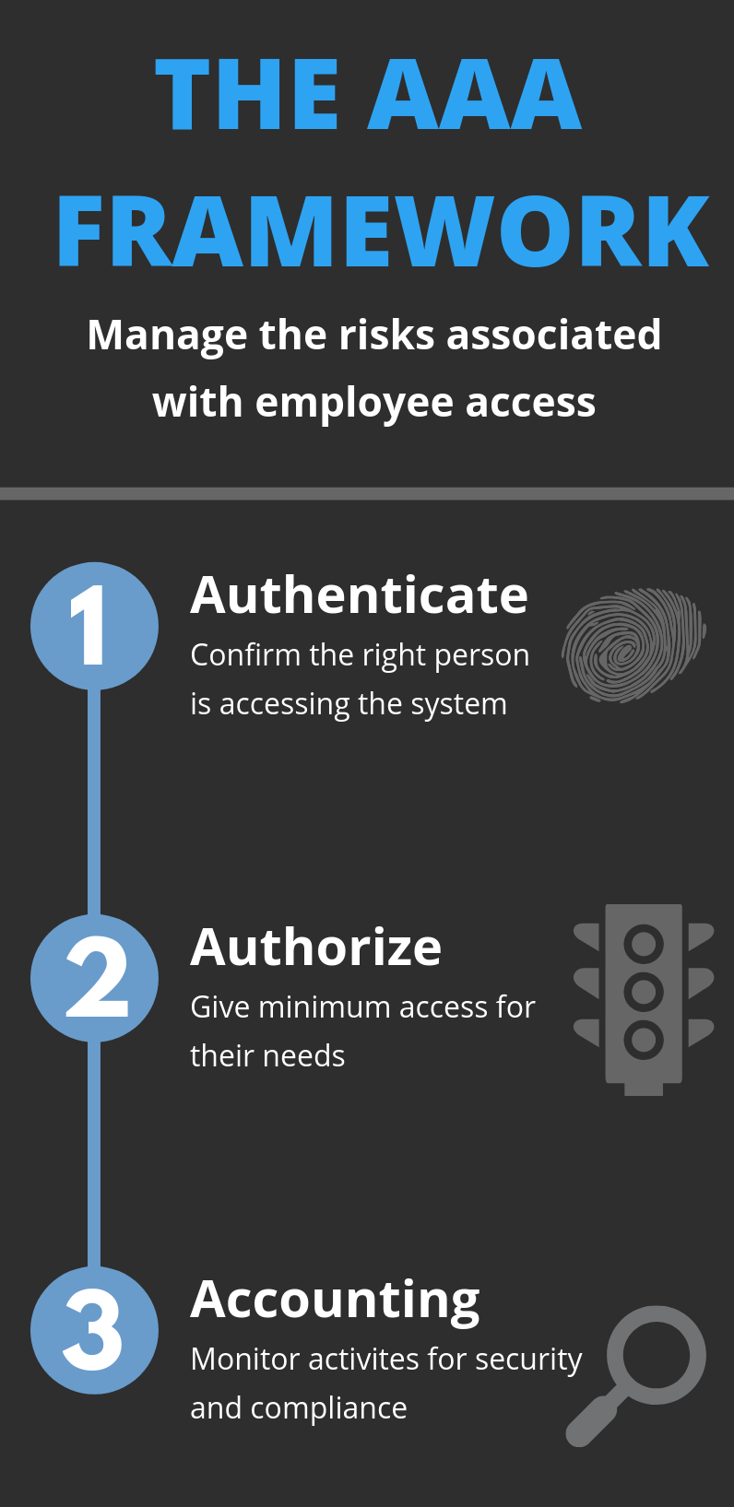
TRIPLE-A POLICIES
Authentication – Identifying a user
Authorization – Authorize user for access
Accounting – Track user’s activity

Slide 8
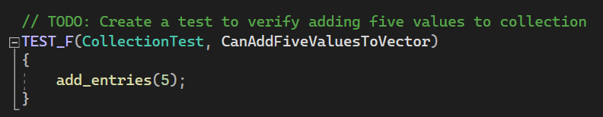
Unit Testing (Test 1)
Testing STD-001 Data Value, and STD-005 Memory Protection
Test 1 – Verify Adding 5 Values to Collection

Slide 9
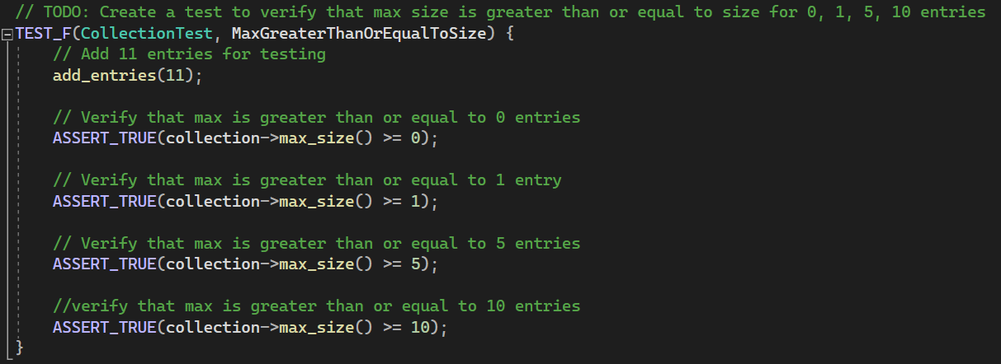
Unit Testing (Test 2)
Test 2 – Assert That Max > or = Values

Slide 10
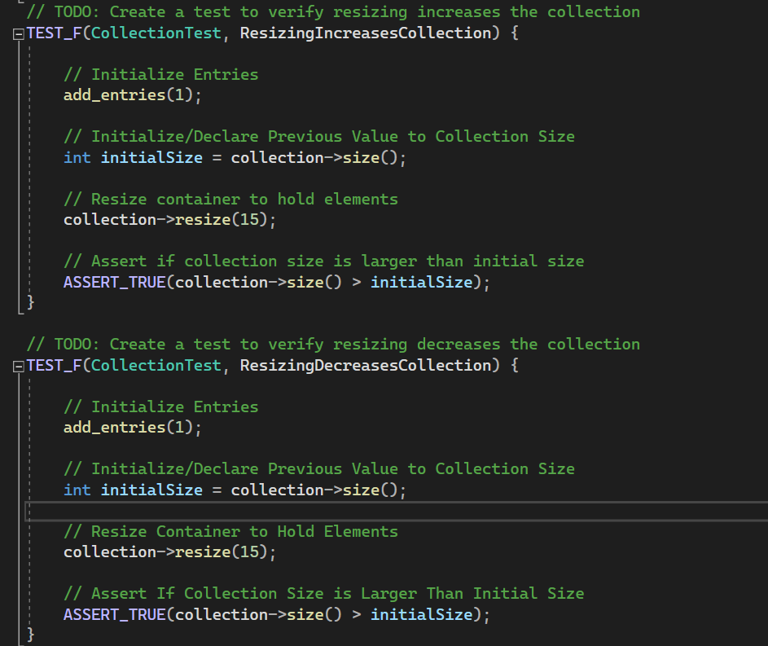
Unit Testing (Test 3)
Test 3 – Assert Container Has Increased/Decreased in Size

Slide 11
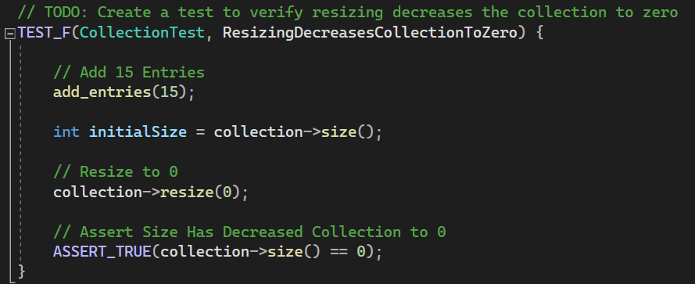
Unit Testing (Test 4)
Test 4 – Assert Collection Has Been Resized to 0

Slide 12
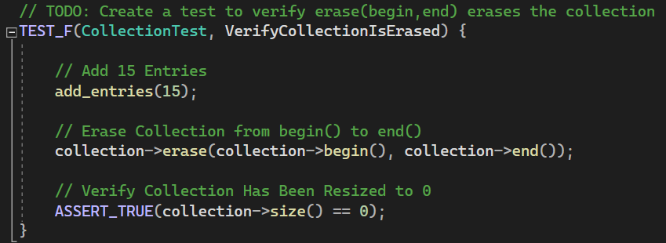
Unit Testing (Test 5)
Test 5 – Assert Collection Has Been Erased

Slide 13

AUTOMATION SUMMARY

Slide 14

TOOLS
DevSecOps – Development, Security, Operation
Tools:
OWASP
ClangTidy
Cppcheck
Parasoft
Coverity
Jenkins
Gitlab

Slide 15
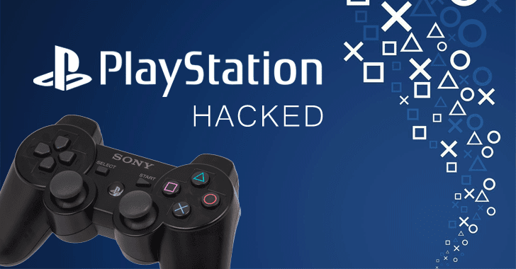
RISKS AND BENEFITS
Essential to Test Early
Potential for Hidden Flaws
Costs Could Increase by 3000% (Dig8al, n.d.)
Sony Lost ≈$171 Million Due to PSN Breach (Martinez, 2011)

Slide 16
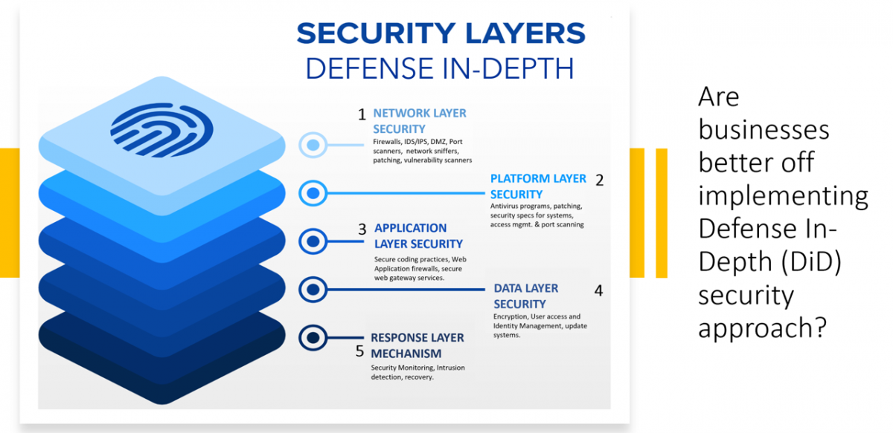
RECOMMENDATIONS
Gaps:
Identify ASAP
Monitor for Threats
Plan Ahead
Recommendations:
Adhere to Standards and Principles
Implement DiD Model
Utilize Encryption, Triple-A Policies

Slide 17
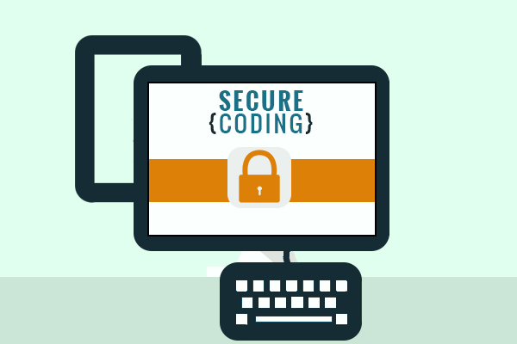
CONCLUSIONS
Utilize DiD
Comprehend Standards and Policies
Implement New Standards

Slide 18
References
Poor Application Security Can Increase Costs by 3,000% — dig8ital. Retrieved 14 April 2022, from https://dig8ital.com/resources/library/poor-application-security-can-increase-costs-by-3000
Poor Application Security Can Increase Costs by 3,000% — dig8ital. Retrieved 14 April 2022, from https://dig8ital.com/resources/library/poor-application-security-can-increase-costs-by-3000

